Slide 1
Asset Allocation using R language
0753907 高英瀚

Slide 2
Motivation
In the Investment course, we’ve learned about efficient frontier and Modern portfolin Theory
Based on MPT , we have pricing model like CAPM, FF3
If we could the use the strategy of MPT and using time seires model to predict and form a portfolio that can perform close to historical data portfolio
If it is close enough, we can then use this method to invest in actual equity market.

Slide 3
How to do?
大立光3008 | 友達2409 | 台灣大3045 | 元大50反一0063R
Beta= 2.09 | Beta= 1 | Beta= 0.2 | Beta= -1
Find assets that I want to put in the portfolio
Fit the return using ARIMA+GARCH
Find efficient frontier and optiamal portfolio by Modern Portfolio Theory using model’s prediction( at a given utility function)
Moving window: using 1 year trading day data to predict 10days return and form a optimal portfolio and then in the next 3 month we use its 4 year past data to find a portfoilio
…………………………
…………………………
Total:798days 2015/01/05~2018/12/28
250days,t=1:250
250days,t=11:260

Slide 4
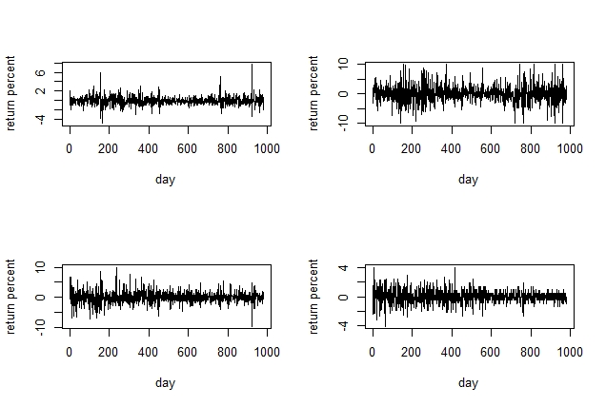
Data
Check if raw data are stationary:
ADF test: all pvalue <0.01 in 12 lags

Slide 5
Data
Use function “auto.arima” , results are as follow:
Yuanda: arma(2,3)
Yoda:arma(1,0)
Daliguang:arma(0,1)
Taigeda:arma(4,4)

Slide 6
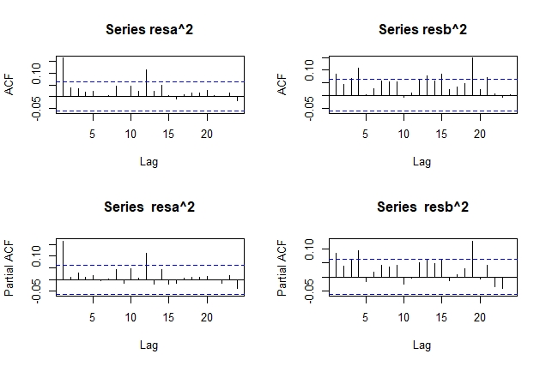
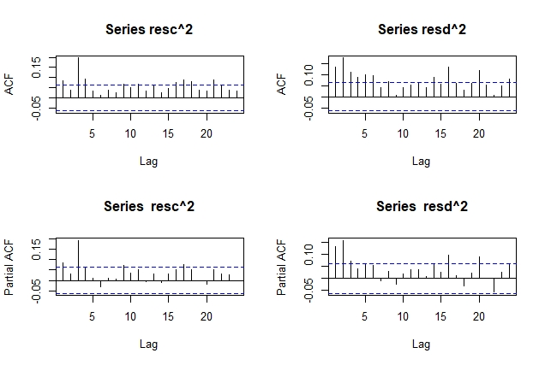
Testing for ARCH effect: Box.test p value
Residual_a: 0.0000037
Residual_b: 0.000183
Residual_c: 1.827*10^-10
Residual_d: 5.551*10^-16
They all have ARCH effect

Slide 7
Fit garch (1,1)
Summary()
Qqnorm() to see the residuals are normal
All of them are not normal
Use garchFit(~1+garch(1,1),data = da2,trace = F, cond.dist = "std")
Ljung-Box Test R^2 Q(10) 6.264604 0.792564
Ljung-Box Test R^2 Q(15) 11.07092 0.7475512
Ljung-Box Test R^2 Q(20) 14.86309 0.7841873
Ljung-Box Test R^2 Q(10) 1.33993 0.9993534
Ljung-Box Test R^2 Q(15) 4.129865 0.9972802
Ljung-Box Test R^2 Q(20) 6.183295 0.9986263
Ljung-Box Test R^2 Q(10) 1.33993 0.9993534
Ljung-Box Test R^2 Q(15) 4.129865 0.9972802
Ljung-Box Test R^2 Q(20) 6.183295 0.9986263
Ljung-Box Test R^2 Q(10) 1.33993 0.9993534
Ljung-Box Test R^2 Q(15) 4.129865 0.9972802
Ljung-Box Test R^2 Q(20) 6.183295 0.9986263
The four garch’s residual do not have ARCH effect

Slide 8
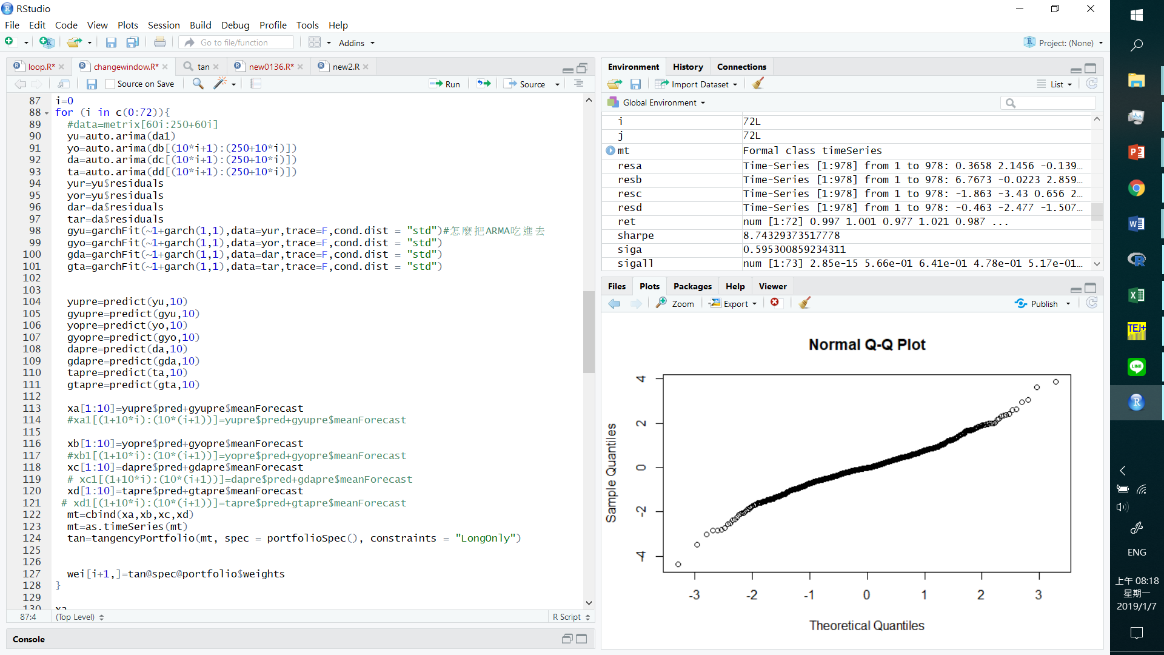

Slide 9
Resualt
Use 250 trading day data to predict 10days
Use function “tangencyportfolio” to get the 10days weight
Use weight times the corresponding 10 days cumulate return
Predict 10 day portfolio has 1.51084 return, or 151% return in 728 trading days, almost 3 year
Sharpe ratio (3year)
=(51.084%-2.57%)/5.548%
=8.7433%
元大 3 year historical cumulated return: 0.6241906
友達 3 year historical cumulated return: 1.694765
大立光 3 year historical cumulated return: 1.9144
台哥大 3 year historical cumulated return: 1.277854

